Slide 1
FUNDAMENTALS
Lecture-1
Basics of Problem Solving
Flowcharts, PseudoCode
Prateek Narang
1

Slide 2
Course Structure
October 26, 2016
Basics of Problem Solving
Programming Fundamentals
Object Oriented Programming
Data Structures

Slide 3
What does a computer do?
October 26, 2016
Input
Output
Computer

Slide 4
Tool for solving problems with data
October 26, 2016
To communicate the solution we create Programs.
So a program is a sequence of instructions that tells a computer how to perform a task.
When computer follows the instructions we say it executes the program.

Slide 5
It’s a machine!
October 26, 2016
Computers are a machine, and at the most basic level, they are collection of switches – where 1 represents “on” and 0 represents “off”.
Everything that a computer does is implemented in this most basic of all numbering systems – binary
So if you want to communicate directly we need to talk to in binary

Slide 6
What does machine understands?
October 26, 2016
Binary Instructions
R Type
[op | rs | rt | rd | shamt | funct]
I Type
[op | rs | rt | address/immediate]
J Type
[op | target address ]
Notes:
What does Computer understands is MACHINE CODE Or BINARY CODE
MIPS
R-
000000 00001 00010 00110 00000 100000
add $1 $2 $6
$6 = $1 + $2
I-
100011 00011 01000 00000 00001 000100
$8 = content of ($3 + 68)
J-
000010 00000 00000 00000 10000 000000
Jump to address 1024
jal
Operation code – such as addition or subtraction.
Operands – that identify the data to be processed.
Machine language is machine dependent as it is the only language the computer can understand.
Very efficient code but very difficult to write.

Slide 7
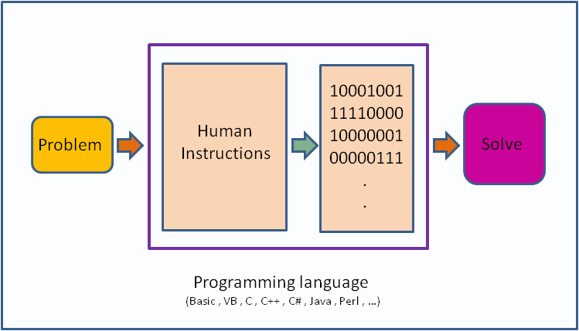
October 26, 2016

Slide 8
Its nearly impossible to write in Binary!
October 26, 2016

Slide 9
What is programming language?
October 26, 2016
A programming language is a set of rules that provides a way of telling a computer what operations to perform
It provides a linguistic framework for describing computations.
A programming language also has words, symbols and rules of grammar.
The grammatical rules are called syntax

Slide 10
High/Low Level Languages!
October 26, 2016
C++/ Java/ Python
Assembly language
Machine Code
ARM/MIPS/IBM
Notes:
In assembly language
add $r1, $r1, $r2
beq $r1, $r2, L1
j L1
li $t1, 5

Slide 11
How do we work with High Level?
October 26, 2016
Magic Box
Compiler
000000 00001 00010 00110 00000 100000
sum = I + j;
Linker
In High level
In Machine Code

Slide 12
Before we write a program for a solution we need an Algorithm.
October 26, 2016

Slide 13
So what is an algorithm?
October 26, 2016
An algorithm is a self-contained step by step set of operations to be performed in order to solve a problem.
Its an effective method that can be expressed within a finite amount of space and time and in well-defined formal language for solving a problem.
Another way to describe an algorithm is a sequence of unambiguous instructions.

Slide 14
Expressing Algorithms?
October 26, 2016
Algorithms can be expressed in many kind of notations, including natural languages, pseudocode, flowcharts, etc.
Natural Language expressions of algorithms tend to be verbose and ambiguous, and are rarely used for complex or technical algorithms.
Programming languages are primarily intended for expressing algorithms in a form that can be executed by a computer.

Slide 15
Two basic aspects of programming
October 26, 2016
Data
Instructions

Slide 16
What are instructions?
October 26, 2016
Its an order given to computer.
At lowest level each of these is a sequence of 0s and 1s.
In assembly language, each statement is one instruction but in high level each statement can be further broken into multiple steps.

Slide 17
Read Principal, Rate & Time and Print SI
October 26, 2016
Start
Read P, R, T
SI = (P*R*T)/100
Output SI
End

Slide 18
Find largest of three numbers
October 26, 2016
Start
Read A,B,C
Is A > B and
A > C
Yes
Print A
No
Is B > A and B > C
Yes
Print B
No
Print C
End

Slide 19
Read a & d, print 10 numbers of form a+d, a+2d, a+3d…
October 26, 2016
Start
Read a, d
Let I = 1
Yes
I = I + 1
Is I <= 10
Output term
No
End
term = a + I * d

Slide 20
Given N, print all numbers from 1 to N
October 26, 2016
Start
Read N
Let I = 1
Add 1 to I
Yes
Is I <= N ?
Output I
No
End

Slide 21
Time to try?
October 26, 2016
Read five numbers and print their average
Given N, find sum of even numbers from 1 to N
Given N, check if its prime or not

Slide 22
What is pseudocode?
October 26, 2016
A notation resembling a simplified programming language, used in program design
It allows designers or lead programmers to express the design in great detail and provides programmers a detailed template for the next step of writing code in a specific programming language

Slide 23
Check if a number is prime or not?
October 26, 2016
Start
Read N
I = 2
Is I < N ?
No
Print
“IS PRIME”
Add 1 to I
Yes
No
Is N is divisible by I ?
Yes
Print
“NOT PRIME”
End

Slide 24
Pseudocode- Check if N is prime?
October 26, 2016
read N
I ← 2
While I < N do
if N is divisible by I then
print “NOT PRIME”
exit
endif
I ← I + 1
endwhile
print “IS PRIME”
exit

Slide 25
Pseudocode –Largest of N numbers
October 26, 2016
read N
I ← 1, L ← -100000
while I < N do
read num
if num > L then
L ← num
endif
I ← I + 1
endwhile
print L
exit

Slide 26
Lets try one more pattern!
October 26, 2016
1
123
12345
1234567
123456789
read N
i ← 1
while i <= N do
j ← 1
while j <= n-i do
print ‘ ‘
j ← j + 1
endwhile
j ← 1, value ← 1
while j <= 2*i - 1 do
print value
j ← j + 1
value ← value + 1
endwhile
print ‘\n’
i ← i + 1
endwhile
exit

Slide 27
Time to try?
October 26, 2016
Write pseudocode
Read N and print the below pattern
1
232
34543
4567654
567898765
Given a number N, find sum of its digits

Slide 28
Time to try?
October 26, 2016
Given a list of N integers, find mean, maximum and minimum value. You would be given first N, and then N integers of the list.
Given a number check if it is a member of Fibonacci sequence or not
Read N, and print the following pattern
1
2 3
4 5 6
7 8 9 10
11 12 13 14 15

Slide 29
Time for Brain Teasers!
October 26, 2016

Slide 30
BT - 1: Hour Glasses
October 26, 2016
You have two hourglasses: a 7 minute one and a 11 minute one. Using just two hourglass, accurately time 15 minutes.

Slide 31
Thank You!
Prateek Narang

